Slide 1
Name that solid!
You have 10min – how many names can you get right?

Slide 2
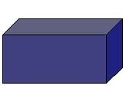
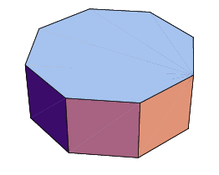
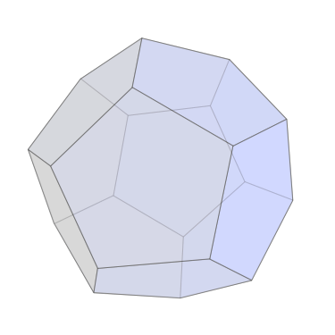
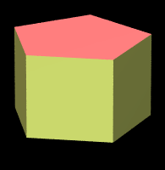
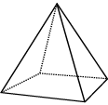
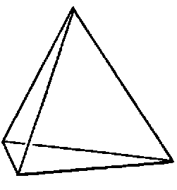



Name that solid!
Triangular Prism
Cone
Cylinder
Octagonal Prism
Cuboid
Dodecahedron
Pentagonal Prism
Square based pyramid
Tetrahedron

Slide 3
y = ½ x + 2

Slide 4
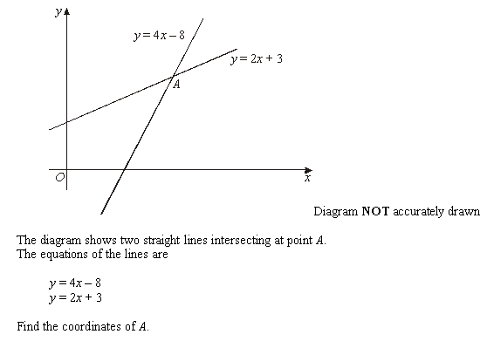
Exam Question

Slide 5
Session Objectives
WALT
Solve graphically simultaneous equations
WILF
Association – checking mathematical tool by linking two techniques

Slide 6
y=2x
y=2

Slide 7
Q: Find a solution to the simultaneous equations y = 1 – x and y = 2x - 5
y = 2x - 5
y =1 - x

Slide 8
Activity
Find a solution to the following sets of simultaneous equations.
y = x + 1
x = 4
y = 2x + 1
y = -x - 2
y = 2x
y = 2 – ½ x
y = 3x – 3
y = 1 - x
y = 5
y = 2x
y = x - 2
y = 1 – 3x
y = ⅓x
y = 2x - 2
x = -4
y = 3x+5
y = ½x - 2
y = -½x - 2

Slide 9
Exam Question

Slide 10
Session Objectives
WALT
Solve graphically simultaneous equations
WILF
Association – checking mathematical tool by linking two techniques

